Slide 1
Unpacking the European Media Freedom Act (EMFA)
Prof. Dr. Mark D. Cole
Professor for Media and Telecommunication Law at the University of Luxembourg / Director for Academic Affairs at the Institute of European Media Law (EMR) European Audiovisual Observatory (EAO) Conference: “EMFA and AVMSD - What's next?“ 3 December 2024, Brussels
Notes:
1

Slide 2
What is the EMFA?
Product no.: (EU) 2024/1083
Sender: EU
Receivers: Member States and others
Sent on: 07 May 2024
Expected delivery: 08 Feb./May 2025, 08 May 2027 at the latest* * some delays may occur as receivers’ assistance is required; some articles will arrive earlier as individual shipments.
Shipping address: European Union (everywhere)
No special customs requirements applicable; article number 17 is flagged for further inspection.
Shipping information: Directly binding Regulation
Stable load, no ‘Fragile’ warning sign required.
Value of goods: priceless (media freedom and pluralism), VAT to be added

Slide 3
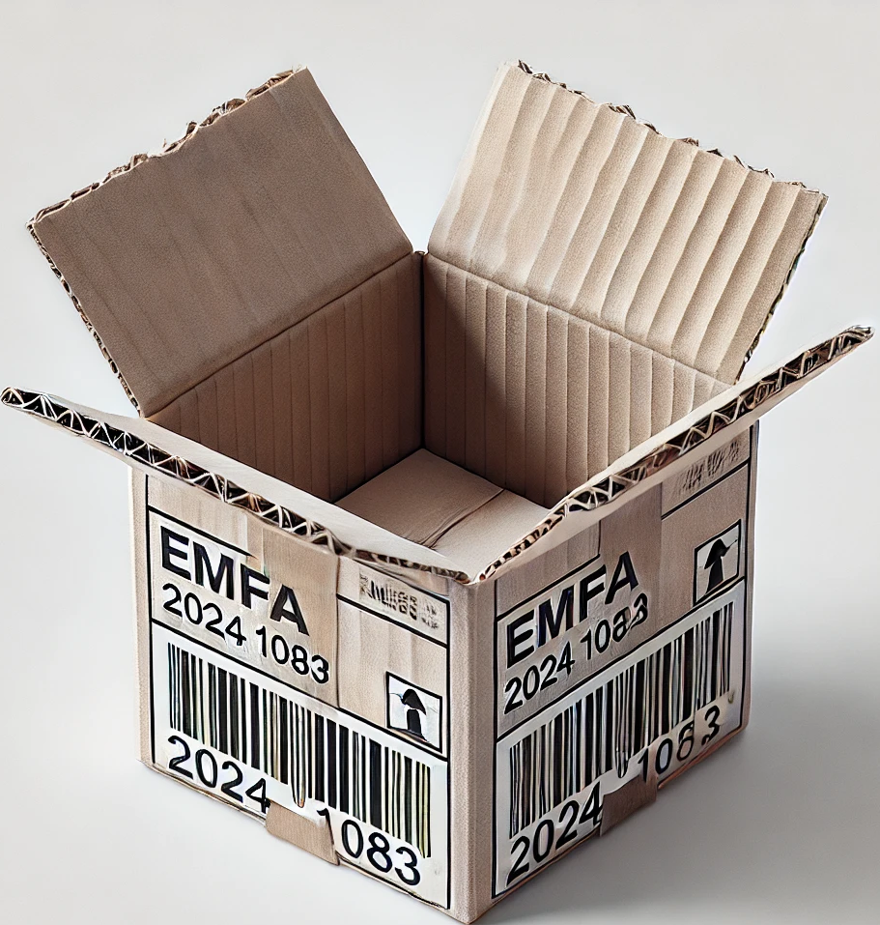
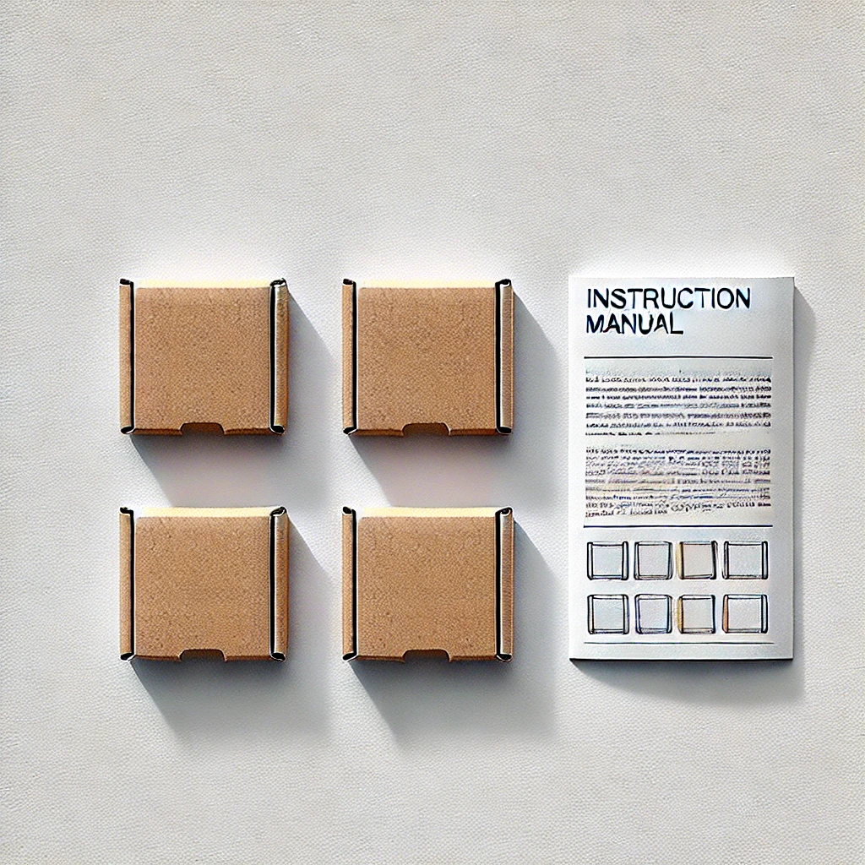
What is in the EMFA? Unpacking…
Rights of recipients/users
Rights of media service providers
Duties of media service providers
Internal media market toolkit

Slide 4
What is in the EMFA? Unpacking…
List of content (checked and cleared for further processing)
Rights of recipients/users - 2x
2024-1083-A.3: access to plural and independent media content (no warranty awarded by shipper)
2024-1083-A.21: customisation of media offerings (delivery note to be sent to manufacturers, developers and importers of devices and user interfaces)
Rights of media service providers – 3x
2024-1083-A.4I-II & A.21: protection of editorial independence
2024-1083-A.4III-VIII: protection of journalistic sources
2024-1083-A.18: ’media privilege’ vis-à-vis platforms
Duties of media service providers – 2x
2024-1083-A.6I: media ownership transparency
2024-1083-A.6II: (internal) independence of editorial decisions
Internal media market toolkit – 3x (different variants)
2024-1083-A.22: assessment of media market concentrations (first edition)
2024-1083-A.24: basic rules for audience measurement (first edition)
2024-1083-A.25: allocation of state advertising (first edition)
Rights of recipients / users
Rights of MSPs
Duties of
MSPs
Internal media market toolkit
Instruction manual 1x, includes:
2024-1083-A.7-A.13: Institutional set-up incl. NRAs, Board and Commission
2024-1083-A.14-A.17: cooperation mechanisms (updated version 2.0, new model from 2010-13-ERGA-MoU, requires product no. 2010/13/EU)

Slide 5
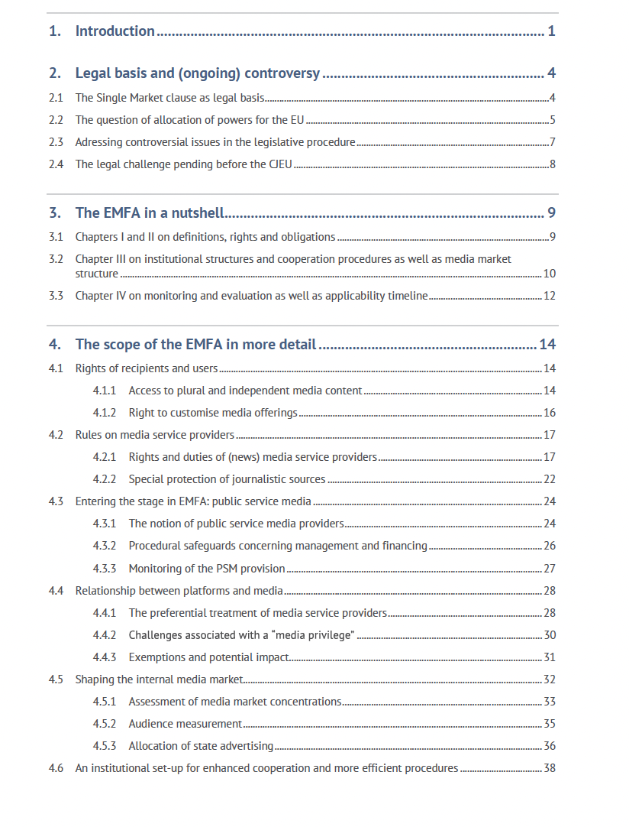
More unpacking…
Now on the EAO website
in EN FR
DE

Slide 6
Instruction manual: Institutional set-up
Exchange
Provides expertise
Board
Commission
Consults
Forum for exchange, conducting opinions, developing best practices, organising dialogues
Consults
Monitoring and evaluation, conducting opinions, issuing guidelines
Forwards deliverables
Consults
Presents monitoring results
Contact Committee
NRAs
Discussion of monitoring results
Applying Chapter III of the EMFA

Slide 7
Consistency and coherence with other (related) legal acts
EMFA and AVMSD …
EMFA amends AVMSD but only to a very limited extent (ERGA → Board);
AVMSD is not included in the list of acts that remain unaffected;
country-of-origin-principle remains untouched irrespective of discussions;
certain rules do not lead to a clear fit taken together (e.g. ownership transparency);
others aim at increasing level of harmonisation such as guidelines competence of EC;
cooperation mechanisms align with substantive rules of the AVMSD, but consider Art. 17 EMFA on reacting to foreign providers’ influence: indicating future changes to the AVMSD?
EMFA and DSA …
EMFA shall “not affect” DSA;
but EMFA addresses partly the same actors (VLOPs and VSPs);
Art. 18 EMFA explicitly gives priority to DSA rules, also in view of the ‘media privilege’;
In actual practice, substantive and procedural rules will have to be coordinated, but no cross-sectoral cooperation rules are laid down for the different “Boards”.
DSA
AVMSD
EMFA
AVMSD and DSA …
DSA remains “without prejudice” to AVMSD, but addresses partly same actors (VSPs) and distributors of AV content;
DSA revolves around “illegal content” but leaves defining that to other legal acts (such as AVMSD).

Slide 8
Institute of European Media Law (EMR) e.V.
Franz-Mai-Straße 6
66121 Saarbrücken
Germany
Phone +49/681/90676676
Mail emr@emr-sb.de
Web emr-sb.de

