Slide 1
EU legislation in the audiovisual sector
Network of Ukrainian media lawyers, training session
25 October 2024, Ukraine
Amélie Lacourt
Legal Analyst
European Audiovisual Observatory

Slide 2
The European Audiovisual Observatory
Since 1992
40 member states + European Union
Executive Council
Advisory Committee

Slide 3
The European Audiovisual Observatory
Market and legal information
TOPICS?
Film
Television
Video on-demand
Video-sharing platforms
WHAT?
Reports
Mappings
Databases
Conferences and
presentations
Online Yearbook
Newsletters
FOR WHOM?
European Commission
European Parliament
Governments
Lawyers
Industry
Academics
Journalists

Slide 4
The European Audiovisual Observatory, since 1992
DEPARTMENT FOR LEGAL INFORMATION
Key topics:
Film funding
Promotion of European works
Protection of children from harmful content
AI
Copyright
…
Services:
IRIS Merlin: media law database
AVMSDatabase: transposition of the Directive
Country pages
PSM tables
European works tables
…

Slide 5
The European Audiovisual Observatory, since 1992
DEPARTMENT FOR MARKET INFORMATION
Services:
Yearbook
Key Trends
Lumière: film admissions lumiere.obs.coe.int
Lumière VOD: directory of film and TV content on VOD in Europe lumierevod.obs.coe.int
Mavise: AVMS, VSPs and their jurisdiction in Europe
mavise.obs.coe.int
Key topics:
Production and circulation of films and TV programmes
TV channels and on-demand services
Cinema screens density
Film financing
Visibility and origin of content available on VOD

Slide 6
The regulatory frameworks of the audiovisual sector in the EU

Slide 7
Audiovisual Media Services Directive

Slide 8
The Audiovisual Media Services Directive (AVMSD)
BEFORE 2018
AVMS Directive 2010/13/EU E-Commerce Directive
TV broadcasting
VOD services
Video-sharing platforms

Slide 9
The Audiovisual Media Services Directive (AVMSD)
AFTER 2018
AVMS Directive 2018/1808
TV broadcasting
VOD services
Video-sharing platforms

Slide 10
The Audiovisual Media Services Directive (AVMSD)
KEY CHANGES – Towards more level playing field
Establishment criteria / jurisdiction + freedom of reception and retransmission
Promotion of European works for VOD services
Audiovisual commercial communications
Video-sharing platforms
Protection of minors
Independence of National Regulatory Authorities (NRAs)
Transparency of media ownership and promotion of media pluralism

Slide 11
Relevant EAO online
services and publications

Slide 12
The Audiovisual Media Services Directive (AVMSD)
AVMSDatabase
Database on the transposition of the AVMS Directive into national legislation.
https://avmsd.obs.int

Slide 13
The Audiovisual Media Services Directive (AVMSD)
AVMSDigest
The promotion of European works (2023)
Safe screens: Protecting minors online (Fall 2024)
https://rm.coe.int/avmsdigest-the-promotion-of-european-works

Slide 14
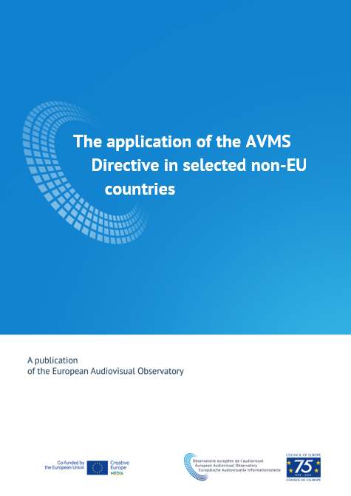
The Audiovisual Media Services Directive (AVMSD)
Mapping on the application of the AVMSD in selected non-EU countries
Study on legal developments in the media field in a range of non-EU countries conducted by the EAO in 2022 and 2023 and published in April 2024.
https://www.obs.coe.int/en/web/observatoire/mapping-reports

Slide 15
Mapping on the application of the AVMSD in selected non-EU countries

Slide 16
Mapping on the application of AVMSD in selected non-EU countries
PROJECT SCOPE
11 countries covered – incl. candidate countries:
Albania, Armenia, Bosnia and Herzegovina, Georgia, Moldova, Montenegro, North Macedonia, Serbia, Tunisia, Ukraine, Kosovo

Slide 17
Mapping on the application of AVMSD in selected non-EU countries
KEY-FINDINGS
Mostly in line with AVMSD 2010
The majority of the 11 countries covered broadly contained or reflected the provisions of the AVMSD 2010
Push towards legal reforms in line with AVMSD 2018
Updating and additions of definitions (e.g. VSPs, UGC…)
Level-playing field for linear/on-demand AVMS re. European works
Relaxation of rules on audiovisual commercial communications
Expansion of rules to include VSPs
Additional provisions regarding the independence of the NRA
Provisions on transparency of media ownership
Strengthening rules on accessibility to people with disabilities

Slide 18
Mapping on the application of AVMSD in selected non-EU countries
GENERAL PRINCIPLES
Principle of non-discrimination addressed in a range of legislation (Constitution, Criminal law, Audiovisual law, specific laws)
Prohibition of incitement to hatred provided in a range of legislations (Constitution, Criminal law, Audiovisual law)
Prohibition of illegal content largely addressed in Criminal codes, except where new amendments to Audiovisual law, in line with AVMSD

Slide 19
Mapping on the application of AVMSD in selected non-EU countries
LEGISLATIVE APPROACHES
Collaborative approaches
A common approach in many of the countries covered is to engage stakeholders extensively in the development of draft laws
New areas covered
All laws and draft laws address the issue of Video Sharing Platforms (VSPs) and secondary legislation is likely to be developed in this area
National Regulatory Authorities (NRAs) frequently play a significant role in most countries in the development of legislative proposals.

Slide 20
Mapping on the application of AVMSD in selected non-EU countries
ONGOING CHALLENGES
Freedom of expression / freedom of the media
Safety of journalists and media workers
Financial situation of the media sector
Disinformation and online media hate speech
Independence of national regulatory authorities
Funding
Powers of enforcement
Appointment and dismissal of members
Media ownership

Slide 21
The Digital Services Act (DSA)

Slide 22
Digital Services Act (DSA)
Timeline:
Regulation adopted on: 19 Oct. 2022
Directly applicable since August 2023 - Applicable to all platforms since February 2024
The DSA aims to:
Protect users and their fundamental rights online
Prevent the spread of illegal content and disinformation
Foster innovation and competition in the digital market
Increase transparency and accountability of online platforms

Slide 23
Digital Services Act (DSA)
Scope:
Various online intermediaries and platforms operating in the EU, including marketplaces, social networks, content-sharing platforms, app stores…
Impact:
Tiered approach, with obligations varying based on the size and impact of the service provider:
Micro and small enterprises face proportionate obligations
Larger platforms and search engines have more extensive requirements
Non-EU companies offering services in the EU single market must also comply

Slide 24
Digital Services Act (DSA)
KEY DEVELOPMENTS:
Establish transparency reports on platforms’ internal complaint handling system and content moderation activities;
Suspend access to the platform (“for a reasonable period and after notice”) to users frequently disseminating manifestly unlawful content;
Take appropriate measures to ensure a high level of protection of minors and protect the private life of users

Slide 25
Digital Services Act (DSA)
Enforcement and Penalties:
Investigative powers
Fines: up to 6% of global annual turnover for non-compliance
Periodic penalties: up to 5% of the average daily worldwide turnover
Temporary suspension of the service
Joint enforcement by the European Commission and national authorities
Creation of a DSA Transparency Database for content moderation decisions

Slide 26
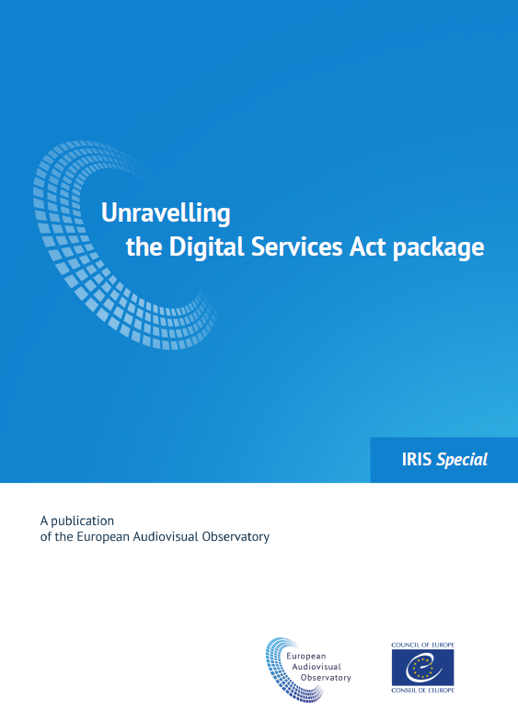
Digital Services Act (DSA)
UNRAVELLING THE DIGITAL SERVICES ACT PACKAGE
IRIS Special, early 2022
https://rm.coe.int/iris-special-2021-01en-dsa-package/1680a43e45

Slide 27
The European Media Freedom Act (EMFA)

Slide 28
European Media Freedom Act (EMFA)
Timeline:
11 April: EMFA is adopted
May 2024: EMFA enters into force
8 August 2025: Full application of the regulation
The EMFA aims to:
Establish a common framework for media services across EU member states
Safeguard media freedom and pluralism (PSM, funding)
Protect editorial independence and journalistic sources
Safeguard against interference (spyware)

Slide 29
European Media Freedom Act (EMFA)
Scope:
Media service providers, including television, radio, on-demand audiovisual services…
Implementation and enforcement:
Monitoring at national level: NRA
Monitoring at EU level: European Board for Media Services
Dispute resolution mechanism for conflicts between media service providers and VLOPs
No range of sanctions or penalties

Slide 30
European Media Freedom Act (EMFA)
IN PARTICULAR…
Citizens must have access to a plurality of editorially independent media content (Art. 3).
Protection of journalists against intrusive measures from authorities (Art. 4).
Measures for the governance and independence of public service media (key appointments through transparent and non-discriminatory procedures, safeguards against dismissals..(Art. 5).
Transparency of ownership: all news and current affairs outlets shall publish information about their owners in a national database (Art. 6).
State financial support and funds received from state advertising should be reported (Art. 6).
New measures to prevent major online platforms from restricting/deleting independent media content. (Art. 18).
Setting up of the European Board for Media Services (replacing ERGA).

Slide 31
European Media Freedom Act (EMFA)
EMFA unfolded…

Slide 32
Thank you for your attention!
For any queries: amelie.lacourt@coe.int

